Slide 1
JAC444 - Lecture 5
Threads
Segment 1 - Basics
Updated By: Mahboob Ali

Slide 2
Objectives
Upon completion of this lecture, you should be able to:
Examine Concurrent Programming Design
Create and Use Threads in Java
Synchronize Threads and Avoid Thread Contention 투쟁
Analyze High Level Concurrency Objects

Slide 3
Threads
In this section you will be learning about:
Process and Threads
Critical Sections
Defining and Starting a Thread
Pausing Thread Execution: Sleep, Interrupts, and Joins

Slide 4
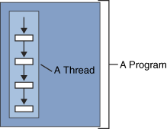
Thread Definition
Thread definition:
A thread is the flow of execution, from beginning to end, of a task.
Threads organize programs into logically separate paths.
Thread can perform task independent of other threads (Multithreading).
Threads can share access to common resources.

Slide 5
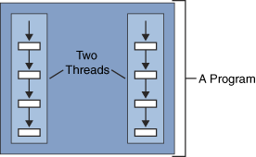
Multithreading
The process of executing multiple threads simultaneously is known as
multithreading.
A Web browser is an example of a multithreaded application. Within a typical
browser, you can scroll a page while it’s downloading an applet or an image, play
animation and sound concurrently, print a page in the background while you
download a new page, or watch three sorting algorithms race to the finish.

Slide 6
Multitasking vs Multithreading vs Multiprocessing vs parallel processing
Multitasking: Ability to execute more than one task at the same time is known
as multitasking.
Chewing gum while walking.
Sending e-mails during a meeting.
Multithreading: We already discussed about it. It is a process of executing multiple
threads simultaneously. Multithreading is also known as Thread-based Multitasking.
Multiprocessing: Multiprocessing more than one CPUs are involved. On the other
hand one CPU is involved in multitasking.
Single core processor.
Dual core processor.
Quad core processor.
Parallel Processing: It refers to the utilization of multiple CPUs in a single
computer system.

Slide 7
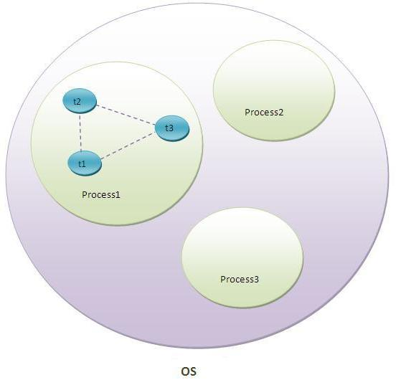
A thread in Java
A thread is a lightweight sub process, a smallest unit of processing.
It is a separate path of execution.
Threads are independent, if there occurs exception in one thread, it doesn't
affect other threads.
It shares a common memory area.

Slide 8
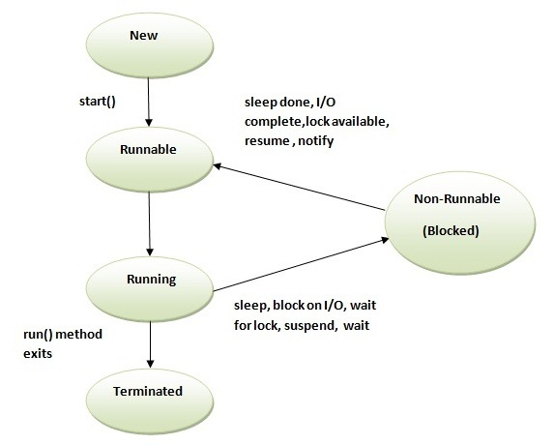
Life cycle of a Thread
The life cycle of the thread in java is controlled by JVM. The java thread states are
as follows:
New
Runnable
Running
Non-Runnable (Blocked)
Terminated

Slide 9
1) New
The thread is in new state if you create an instance of Thread class but before the
invocation of start() method.
2) Runnable
The thread is in runnable state after invocation of start() method, but the thread
scheduler has not selected it to be the running thread.
3) Running
The thread is in running state if the thread scheduler has selected it.
4) Non-Runnable (Blocked)
This is the state when the thread is still alive, but is currently not eligible to run.
5) Terminated
A thread is in terminated or dead state when its run() method exits.

Slide 10
Defining a Thread
There are two ways to create a thread:
Extend Thread Class:
public class MyThread extends Thread { public void run () {
}
}
One must override run() method.
Create a Runnable Object:
public class MyRunnable implements Runnable { public void run() {
}
}
One must implement run() method.

Slide 11
Thread Constructors
Thread()
Thread(Runnable target) Thread(Runnable target, String name) Thread(String name)
Thread(ThreadGroup | group, | Runnable target)
Thread(ThreadGroup | group, | Runnable target, | String name)
Thread(ThreadGroup | group, | String name)

Slide 12
Commonly used methods of Thread class:
Method | Use
public void run() | is used to perform action for a thread.
public void start() | starts the execution of the thread.JVM calls the run() method on the thread. (call stack, run with priority )
public void sleep(long miliseconds) | Causes the currently executing thread to sleep (temporarily cease execution) for the specified number of milliseconds.
public void join() | waits for a thread to die.
public void join(long miliseconds) | waits for a thread to die for the specified miliseconds.
public int getPriority() | returns the priority of the thread.
public int setPriority(int priority) | changes the priority of the thread.
public String getName() | returns the name of the thread.
public void setName(String name) | changes the name of the thread.
public Thread currentThread() | returns the reference of currently executing thread.
public int getId() | returns the id of the thread.

Slide 13
Method | Use
public Thread.State getState() | returns the state of the thread.
public boolean isAlive() | tests if the thread is alive.
public void yield() | causes the currently executing thread object to temporarily pause and allow other threads to execute.
public void suspend() | is used to suspend the thread (deprecated)
public void resume() | is used to resume the suspended thread (deprecated)
public void stop() | is used to stop the thread(deprecated).
public boolean isDaemon() | tests if the thread is a daemon thread. (예) 가비지컬렉터, 워드프로세서의 자동저장, 화면자동갱신 등)
public void setDaemon(boolean b) | marks the thread as daemon or user thread.
public void interrupt() | interrupts the thread.
public boolean isInterrupted() | tests if the thread has been interrupted.
public static boolean interrupted() | tests if the current thread has been interrupted.

Slide 14
Runnable Interface:
The Runnable interface should be implemented by any class whose instances are intended to be executed by a thread.
Runnable interface have only one method named run().
public void run() | is used to perform action for a thread.

Slide 15
Starting a Thread:
start() method of Thread class is used to start a newly created thread. It performs following tasks:
A new thread starts(with new callstack).
The thread moves from New state to the Runnable state.
When the thread gets a chance to execute, its target run() method will run.
class Multi extends Thread{
@override
public void run(){
System.out.println("thread is running...");
}
public static void main(String args[]){
Multi t1=new Multi();
t1.start();
}
}
Output: thread is running...

Slide 16
Create a Runnable Object
class Multi3 implements Runnable{
public void run(){
System.out.println("thread is running...");
}
public static void main(String args[]){
Multi3 m1=new Multi3();
Thread t1 =new Thread(m1);
t1.start();
}
}
Output: thread is running...

Slide 17
Thread Scheduler in Java
Thread scheduler in java is the part of the JVM that decides which thread should run.
There is no guarantee that which runnable thread will be chosen to run by the thread scheduler.
Only one thread at a time can run in a single process.
The thread scheduler mainly uses preemptive or time slicing scheduling to schedule the threads.
Preemptive: 선점 형
The highest priority task executes until it enters the waiting or dead states.
Time Slicing: 시간 분할 형
Task executes for a predefined slice of time and then reenters the pool of ready tasks.

Slide 18
Can we start a thread twice
No.
If you does so, an IllegalThreadStateException is thrown.
public class TestThreadTwice1 extends Thread{
public void run(){
System.out.println("running...");
}
public static void main(String args[]){
TestThreadTwice1 t1=new TestThreadTwice1();
t1.start();
t1.start();
}
}
Output:
running
Exception in thread "main" java.lang.IllegalThreadStateException

Slide 19
What if we call run() method directly instead start() method?
class TestCallRun2 extends Thread{
public void run(){
for(int i=1;i<5;i++){
try{Thread.sleep(500);}
catch(InterruptedException e){System.out.println(e);}
System.out.println(i);
}
}
public static void main(String args[]){
TestCallRun2 t1=new TestCallRun2();
TestCallRun2 t2=new TestCallRun2();
t1.run();
t2.run();
}
}
Output:
1 2 3 4 5
1 2 3 4 5

Slide 20
Method - sleep
The sleep() method of Thread class is used to sleep a thread for the specified amount of time.
class TestSleepMethod1 extends Thread{
public void run(){
for(int i=1;i<5;i++){
try{
Thread.sleep(500);}
catch(InterruptedException e){System.out.println(e);}
System.out.println(i);
}
}
public static void main(String args[]){
TestSleepMethod1 t1=new TestSleepMethod1();
TestSleepMethod1 t2=new TestSleepMethod1();
t1.start();
t2.start();
} }
Output:
1
1
2
2
3
3
4
4

Slide 21
Pausing Execution - sleep
public static void sleep(long millis) throws InterruptedException
public static void sleep(long miliseconds, int nanos)throws InterruptedException
causes the current thread to suspend execution for specified period.
If you sleep a thread for the specified time, the thread schedular picks up another thread and so on.

Slide 22
Pausing Execution - join
public final void join(long millis) throws InterruptedException
The join method allows one thread to wait for the completion of another.
In other words, it causes the currently running threads to stop executing until the thread it joins with completes its task.

Slide 23
Pausing Execution - join
class TestJoinMethod1 extends Thread{
public void run(){
for(int i=1;i<=5;i++){
try{
Thread.sleep(500);
}catch(Exception e){System.out.println(e);}
System.out.println(i);
}
}
public static void main(String args[]){
TestJoinMethod1 t1=new TestJoinMethod1();
TestJoinMethod1 t2=new TestJoinMethod1();
TestJoinMethod1 t3=new TestJoinMethod1();
t1.start();
try{
t1.join();
}catch(Exception e){System.out.println(e);}
t2.start();
t3.start();
} }
Output:
1
2
3
4
5
1
1
2
2
3
3
4
4
5
5

Slide 24
getName(), setName(String) and getId() method
public String getName()
public void setName(String name)
public long getId()
class TestJoinMethod3 extends Thread{
public void run(){
System.out.println("running...");
}
public static void main(String args[]){
TestJoinMethod3 t1=new TestJoinMethod3();
TestJoinMethod3 t2=new TestJoinMethod3();
System.out.println("Name of t1:"+t1.getName());
System.out.println("Name of t2:"+t2.getName());
System.out.println("id of t1:"+t1.getId());
t1.start();
t2.start();
t1.setName(“Some Name");
System.out.println("After changing name of t1:"+t1.getName());
}
}
Output:
Name of t1:Thread-0
Name of t2:Thread-1
id of t1:8
running...
After changing name of t1:Some Name
running...

Slide 25
Example: SimpleThread
public class SimpleThread extends Thread { public SimpleThread(String str) {
super(str);
}
public void run() {
for (int i = 0; i < 3; i++) { System.out.println(i + " " + getName()); try {
Thread.sleep((long)(Math.random() * 1000));
} catch (InterruptedException e) {}
}
System.out.println("DONE! " + getName());
}
public static void main (String[] args) {
new SimpleThread("First >>>>>>>>>").start(); new SimpleThread("Second <<<<<<<<<").start();
System.out.println("DONE ALL!");
}
}
Jordan Anastasiade – Java Programming Language Course 13

